Slide 1
Design Idea for Dimly Lit Roads in India
Project in Design Thinking Laboratory

Slide 2
Contents
01
02
03
04
05
06
History and Necessity
Evolution of Cars
Design Changes over the Years
Market Impact
Types of Cars and Materials
Environmental Impact

Slide 3

Prepared By:
Krishnaraj PT Presentation, Calculations, Report
Tirth Thesiya
Merits Demerits and Diagrams
Pranaav Suratwala –
Materials and Components
Devanshu Surana –
Theory and Idea Rack Analysis

Slide 4
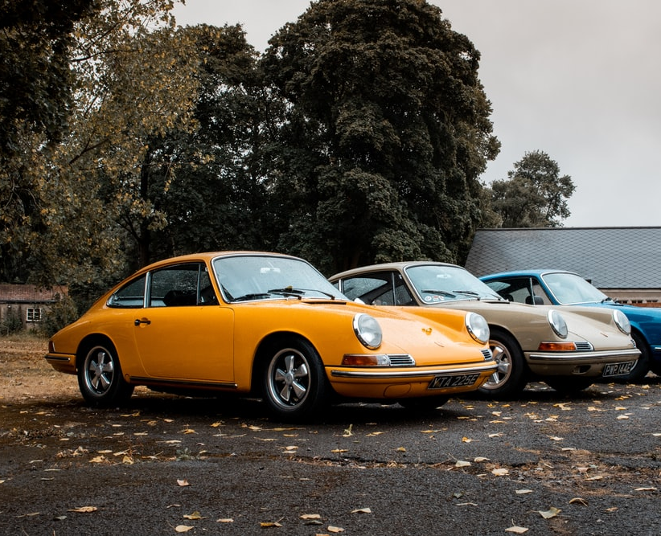

Thanks for listening!

